Slide 1
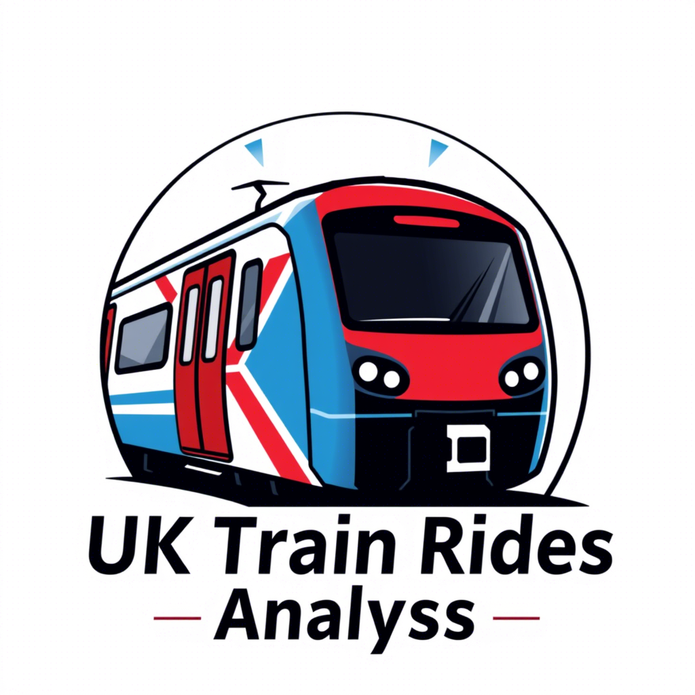

UK Train Rides: Data Analysis & Insights
Understanding Delays, Refunds, and Passenger Behavior Data Vanguard
8 April 2025

Slide 2

Dataset Overview
This presentation utilizes the railway dataset, a comprehensive collection of 31,635 UK train journey records. With 21 distinct columns, the data captures a wide range of information including purchase details (like Ticket Class, Price, and Railcard usage), journey specifics (departure/arrival stations and times), operational performance (delay status, duration, and reasons), and customer outcomes (refund requests). Initial checks revealed some missing values, particularly for Railcard status and precise delay timings, which were addressed during analysis

Slide 3
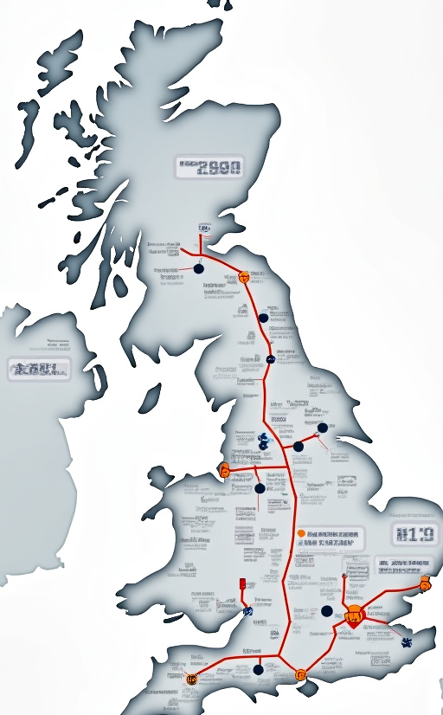
Project Overview
Goal: Analyze UK train journey data (railway) to uncover patterns in delays, refund requests, and passenger behavior.
Demographics & Delay Tolerance
Online vs. Station Purchases
Ticket Price & Refund Correlation
'Phantom Delays' Analysis
Identifying Underserved Routes
Predicting Refund Requests
Impact of Incentives on Minor Delays
Strategies for Delay Reduction

Slide 4
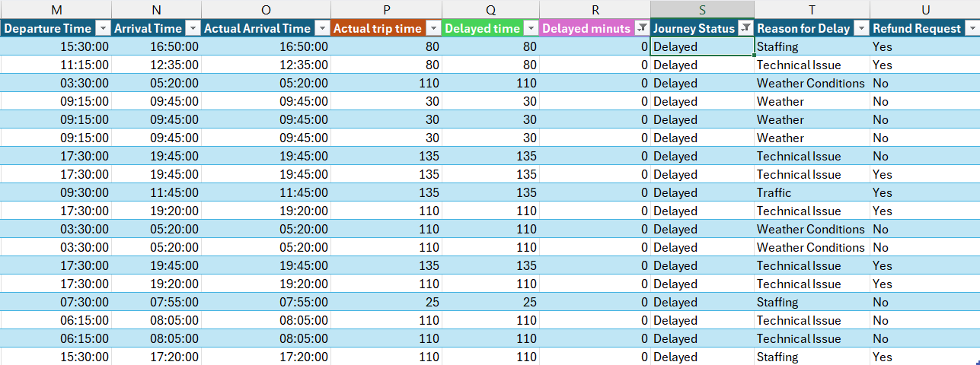
Data Cleansing
While calculating the variance between actual trip times and delays, it was identified that 18 trips were categorized as delayed. Furthermore, some of these trips were erroneously marked as refund requests. To ensure accuracy in our analysis and provide clarity for the business owner’s review, we opted to exclude these trips to avoid any potential misunderstandings.

Slide 5
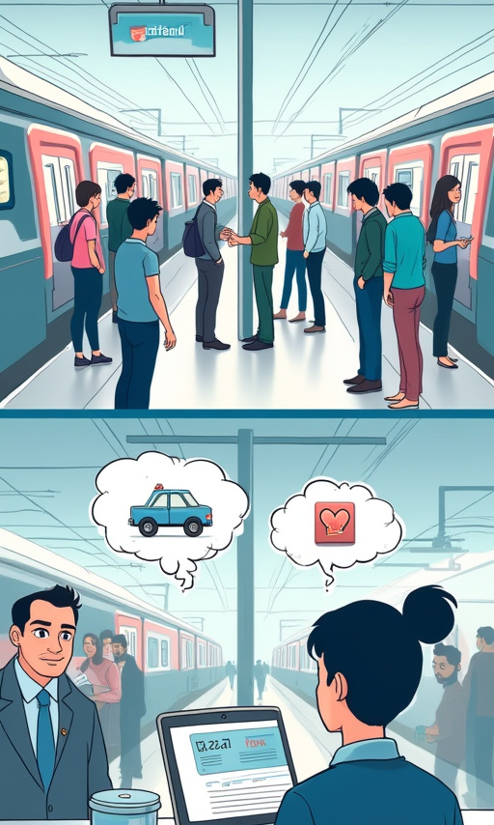
Question 1: How do passenger demographics (Railcard type, Ticket Class) influence their tolerance for delays and likelihood of requesting refunds?
Analysis Approach
Grouped data by Railcard type and Ticket Class to analyze delay tolerance and refund likelihood.
Identified top reasons for delays among delayed journeys.
Key Findings
Railcard Type : Seniors : Shortest delays (0.54 min), highest refund rate (4.25%). Adults : Longest delays (6.32 min), lowest refund rate (8.62%). Disabled : Moderate delays (2.11 min), lowest refund rate (1.94%).
Ticket Class : First Class: Slightly longer delays (3.48 min) but higher refund rate (3.66%). Standard: Moderate delays (3.23 min) and lower refund rate (3.49%).
Delays : Total delayed journeys: 2,274. Top reasons: Weather (755), Technical Issues (464), Signal Failures (242).

Slide 6
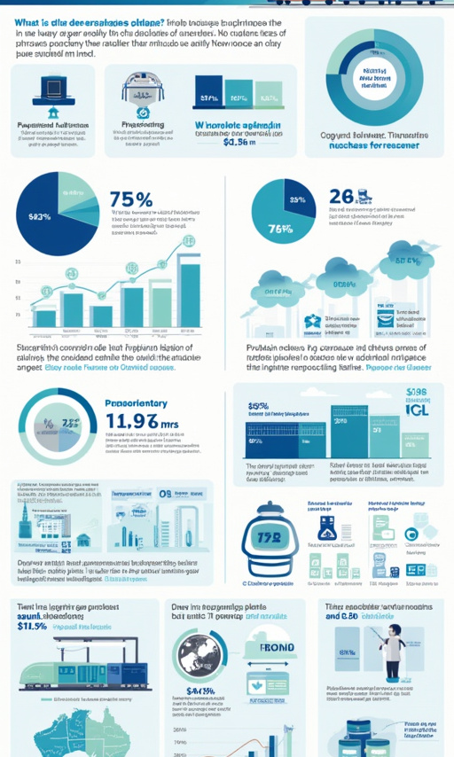
Question 2: Do online purchasers behave differently than station buyers (e.g., refund habits, route choices)?
Analysis Approach
Cleaned refund data by converting refund requests to numerical values (Yes=1, No=0).
Identified unique purchase types (Online and Station) from the dataset.
Compared refund rates between online and station purchases using groupby analysis.
Analyzed top routes for both online and station purchases by counting popular departure-arrival pairs.
Key Findings
Refunds : Online: 2.21% refund rate. Station: 5.34% refund rate.
Top Routes: Online : Manchester → Liverpool, London → Reading, London → Birmingham. Station : Manchester → Liverpool, London → Birmingham, London → York.

Slide 7
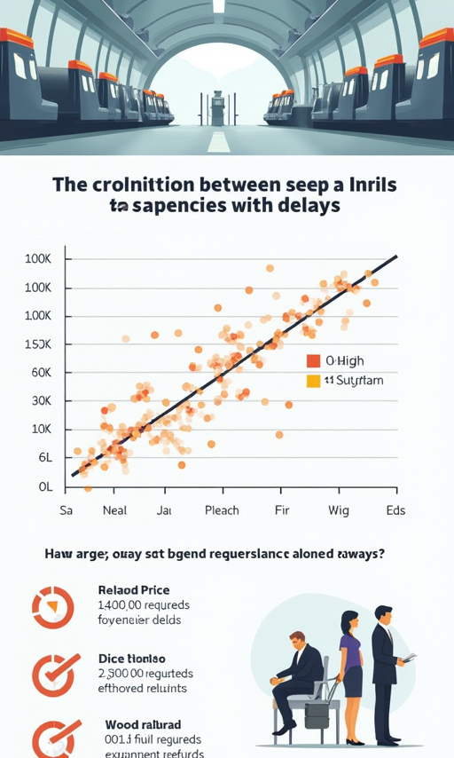
Question 3: Is there a correlation between ticket price and passengers' patience with delays (e.g., do pricier tickets = higher refund demands)?
Analysis Approach:
Calculated Pearson correlation between Price and Delayed minuts / Refund Requested.
Created price categories ('Low', 'Medium', 'High') using pd.cut.
Analyzed average delays and refund rates by price category.
Visualized relationships using scatter and bar plots.
Visual Insights
Scatter plot shows no strong pattern between price and delays or refunds.
Bar chart highlights that higher-priced tickets have a slightly higher refund rate, despite experiencing fewer delays.

Slide 8
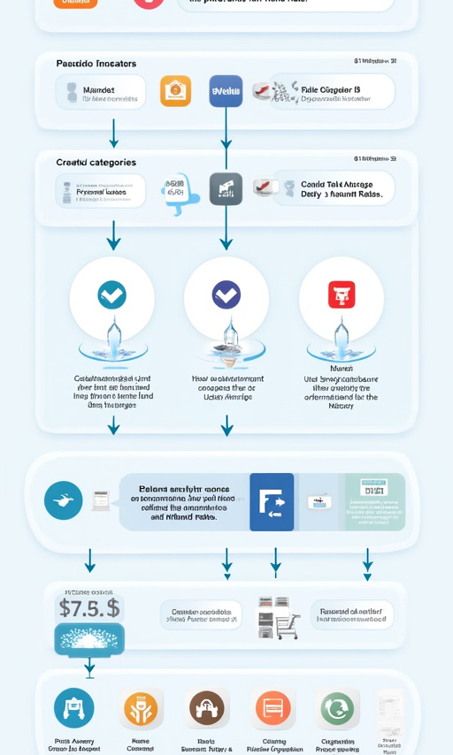
Q3: Price Correlation Insights
Key Findings
Correlations - Price-Delay Correlation : 0.16 (weak positive correlation). Higher-priced tickets do not strongly correlate with longer delays. - Price-Refund Correlation : 0.07 (very weak correlation). Higher-priced tickets do not strongly influence refund requests.
Refund Rates by Price Category: - Low Price : Refund rate = 2.54%, Average delay = 3.62 minutes. - Medium Price : Refund rate = 2.67%, Average delay = 2.92 minutes. - High Price : Refund rate = 3.13%, Average delay = 1.10 minutes - Insight : Passengers with higher-priced tickets tend to experience shorter delays but have slightly higher refund rates.

Slide 9
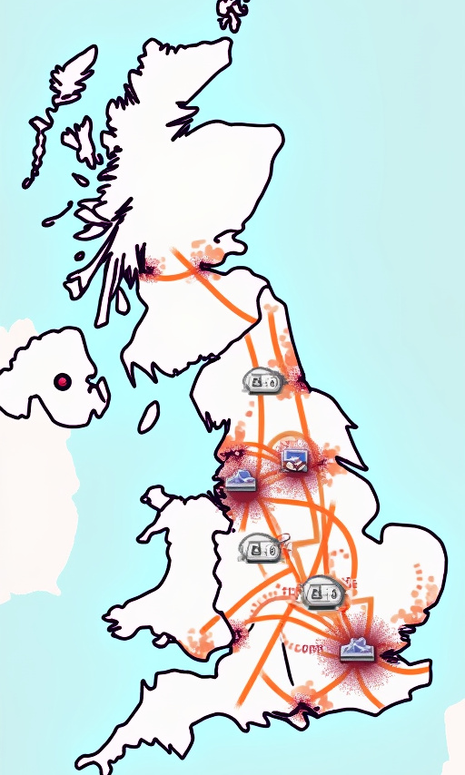
Q4: Which station pairs have the highest 'phantom delays' (delays not explained by obvious factors like weather)?
Analysis Approach:
Filtered for delayed journeys. Defined 'obvious' reasons (e.g., 'weather'). Classified delays as 'Phantom' if the reason was not obvious.
Key Findings:
Top Phantom Delay Routes: Several routes show 100% phantom rates: London Kings Cross -> York Liverpool Lime St -> Manchester
High Volume Phantom Routes: Manchester -> Liverpool Lime St (72% Phantom Rate) London Euston -> Birmingham New St (59% Phantom Rate)
Top Phantom Causes: Technical Issue (34.3%) Signal Failure (33.3%) Staff Shortage (26%)

Slide 10
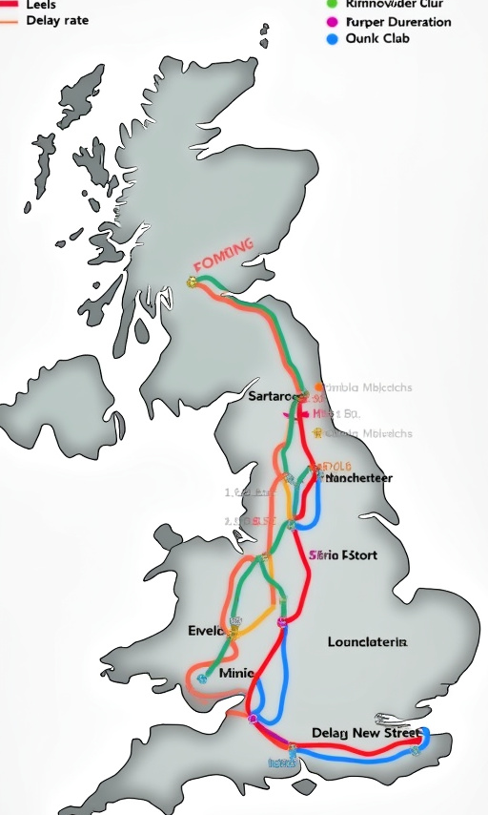
Q5: Which route clusters (considering price, delay risk, journey time) are potentially underserved and could benefit from targeted promotions?
Analysis Approach:
Calculated average price, delay rate, average delay duration (for delayed journeys), and average trip time per route. Created a composite 'Underserved Score' favoring routes with: Lower Price (Inverse weighting) Higher Delay Rate & Longer Average Delays Longer Journey Duration
Key Findings:
Manchester Piccadilly -> Leeds: Avg Price: £10.36 (Below Median) Delay Rate: 45.1% (Above Median) Avg Trip Time: 110 mins (Above Median) Birmingham New Street -> Manchester Piccadilly: Avg Price: £11.16 (Below Median) Delay Rate: 42.6% (Above Median) Avg Trip Time: 92 mins (Above Median)

Slide 11

Question 6: Can we build a model to predict which delayed passengers will request refunds, using information known after the journey (like actual delay)?
Analysis Approach
Cleaned and preprocessed data, encoding variables and engineering features.
Built two Random Forest models: Model 1 : Used post-delay features (e.g., delay duration, reason). Model 2 : Used booking-time features (e.g., ticket class, price).
Evaluated performance using precision, recall, F1-score, and accuracy.

Slide 12
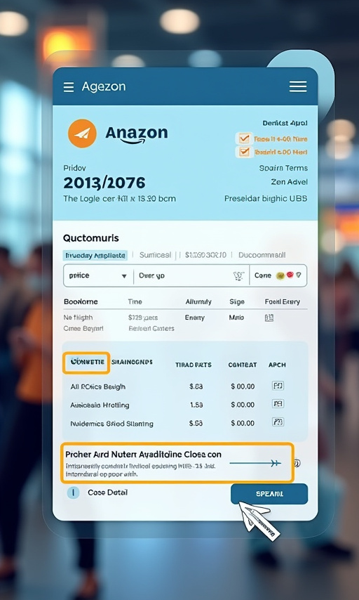
Q6: Can We Predict Refund Requests?
Key Findings
Model Performance : Model 1 : 95% accuracy; strong at predicting refunds using delay details. Model 2 : 92% accuracy; less effective due to reliance on booking-time data.
Top Predictors : Post-Delay: Departure Hour, Delayed Minutes. Booking-Time: Price, Ticket Class.
Example Predictions : First Class: 1.8% refund probability. Standard Class: 7.1% refund probability.
Insights : Delay-specific data is more predictive than booking-time data. Operational factors heavily influence refund likelihood.

Slide 13

Question 7: Would offering small incentives (e.g., loyalty points, upgrades) potentially reduce refund requests for minor delays?
Analysis Approach:
Filtered journeys with delays > 0 and < 15 minutes.
Calculated the current refund rate for these minor delays.
Simulated the potential reduction in refunds based on hypothetical incentive effectiveness assumptions (e.g., 65% reduction for loyalty points).
Identified passenger groups (Class/Purchase Type) experiencing the most minor delays.

Slide 14
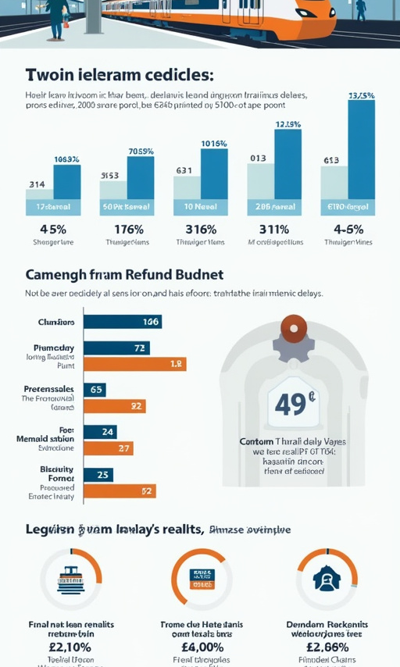
Q7: Incentive Impact Simulation
Key Findings:
Current Rate: Passengers request refunds for ~47.7% of minor delays (<15 mins).
Potential Savings (Example Assumptions): - Loyalty Points (65% effective): Could reduce ~193 refunds to ~68. - Free Upgrade (40% effective): Could reduce ~193 refunds to ~116. - Discount Coupon (75% effective): Could reduce ~193 refunds to ~48.
Target Groups: Standard Class passengers purchasing at the Station experience the highest volume of minor delays (304 instances in the filtered data).
Conclusion: Offering small incentives for minor delays shows significant potential to reduce refund processing costs and improve goodwill. Targeting Standard Class / Station purchasers could be most impactful initially.

Slide 15

Question 8: What’s the cheapest way to reduce delays: improving punctuality at high-traffic stations or optimizing departure schedules?
Analysis Approach:
Identified high-traffic stations (e.g., London Kings Cross, Manchester Piccadilly).
Calculated total delay minutes originating from these stations.
Identified peak hours (7-9 AM).
Calculated total delay minutes occurring during these hours across all stations.
Compared the two total delay figures.
Key Findings:
Total Delay Minutes (High-Traffic Stations): ~93,334 minutes
Total Delay Minutes (Peak Hours 7-9 AM): ~45,746 minutes
Recommendation: Based on this data, focusing on improving punctuality and infrastructure at the identified high-traffic stations appears to offer a greater potential reduction in overall delay minutes compared to focusing solely on peak hour schedule optimization.

Slide 16

Key Insights Summary
Demographics Matter: Adult Railcard holders are most sensitive to delays; Station purchaser's request refunds more often.
Price Isn't Everything: Weak link between ticket price and refund requests; higher prices don't guarantee more patience.
'Phantom Delays' Common: Technical issues, signal failures are major non-weather delay causes, especially on key routes.
Targeting Opportunities: Specific routes (e.g., Man Picc <-> Leeds) identified as 'underserved' (low price, high delay/time).
Prediction Difficulty: Predicting refunds is feasible after a delay occurs, but very difficult at booking time with current data.
Incentives Promising: High refund rate for minor delays suggests incentives could be effective.
Station Focus: Improving high-traffic stations seems more impactful for reducing total delay time than solely peak-hour adjustments.

Slide 17
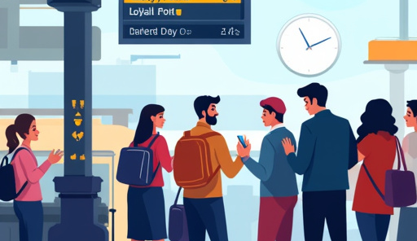
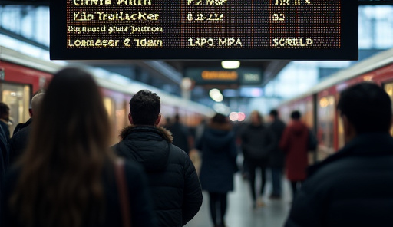

Recommendations
Customer Experience
Consider targeted incentives (e.g., loyalty points) for minor delays, especially for Standard Class / Station purchasers. Investigate 'phantom delays' on high-occurrence routes (e.g., Ldn KC-York, Lpl LS-Man Picc) focusing on technical, signal, and staffing issues.
Operations
Prioritize punctuality improvements at high-traffic stations (Manchester Picc, Liverpool Lime St, London Euston) as this seems key to reducing overall delay minutes.
Data/Modeling
Explore additional features (e.g., real-time network congestion, historical route performance) to improve booking-time refund prediction models. Refine 'Underserved Route' analysis with cost data if available.

Slide 18
Team members
Youssif Sayed Fawzy
Omar Mohamed Abdel Dayem
Modather Osama Mohamed
Abdelrahman Ahmed Mahmoud
Samy Nasser Mohamed Aly
Questions?

